Slide 1
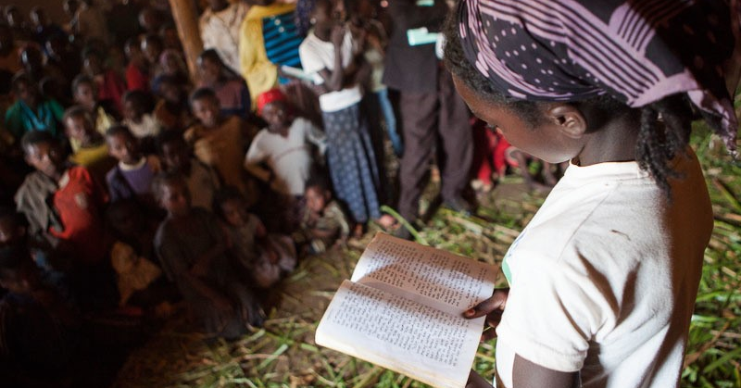
Oral and Written Translation

Slide 2
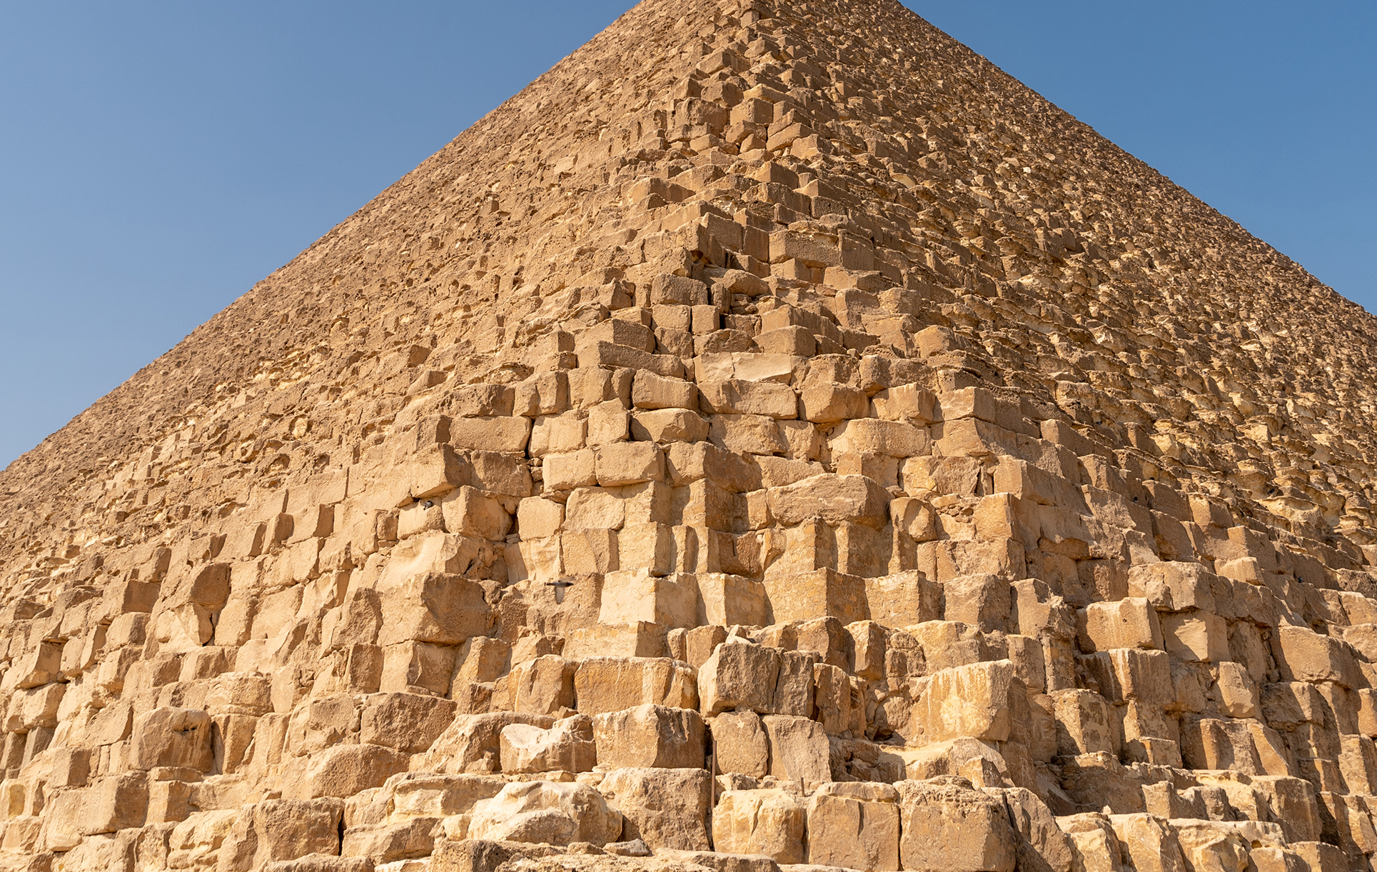
Genesis 11:1–9
Genesis 11:1–9

Slide 3
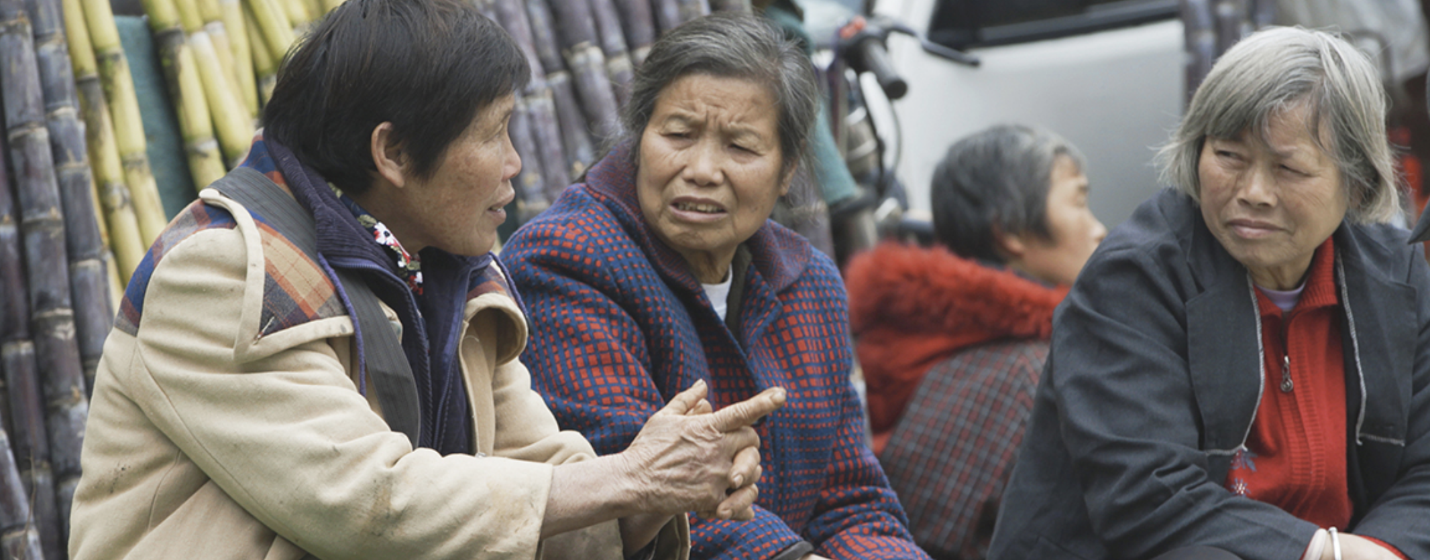
Over 3000 language groups
do not use
a complete written form

Slide 4
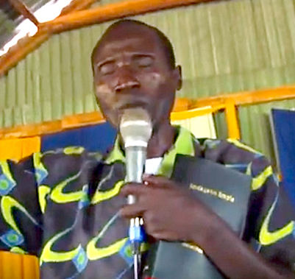
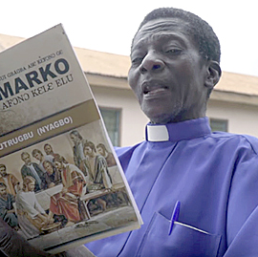
Differences in Oral Communities
Some Oral Communities
Other Oral Communities
Respect oral messages
Express important information orally
Consider oral communication ideal
Respect written messages
Wish important information to be written
Consider written communication ideal

Slide 5
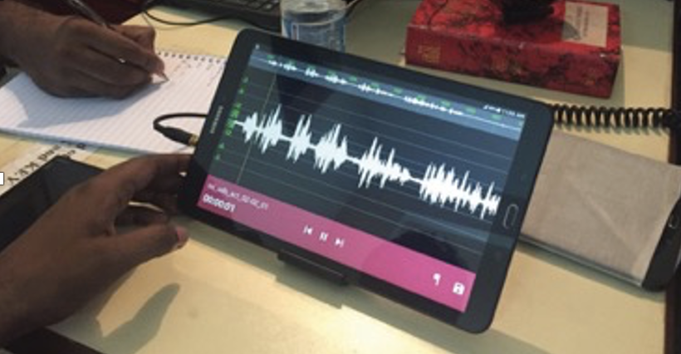
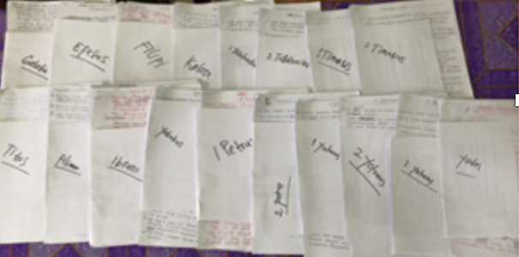
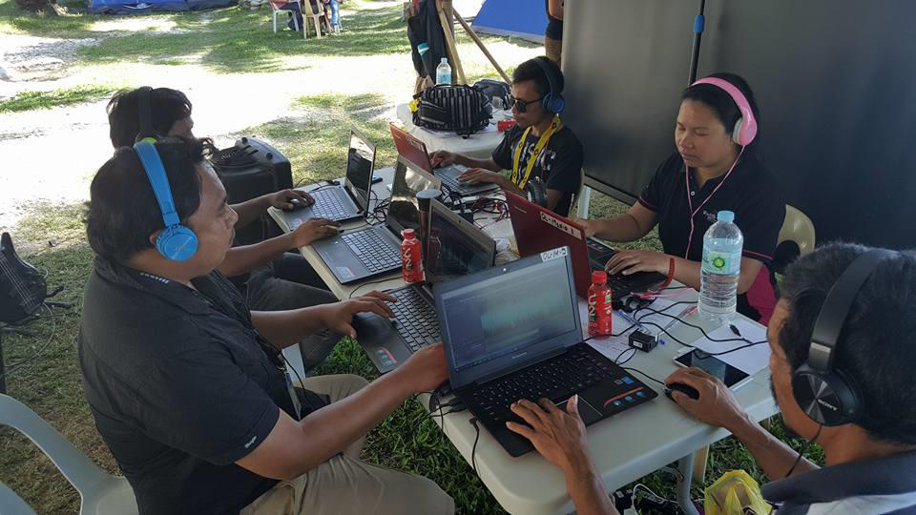
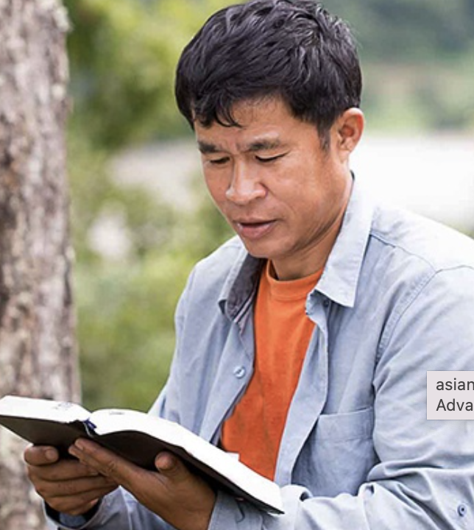
Written Translation
Oral Translation

Slide 6
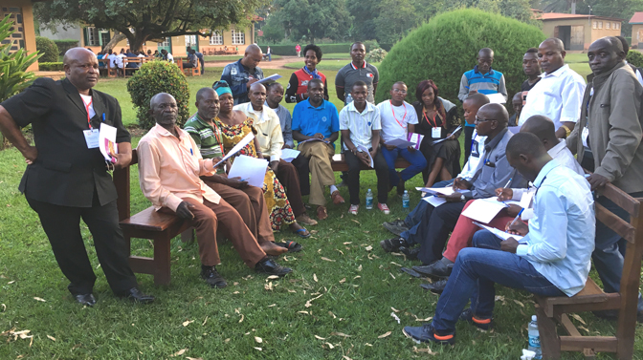

Who Decides?
Local Church
The believers in the community who are invested in getting Scripture for their heart language.

Slide 7
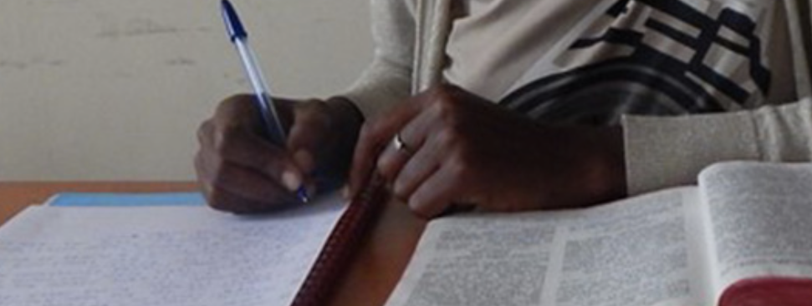
What Should the Church Consider?
Written Translation
Is there a writing system for the language, even if not standardized?
Do the people read and write in their heart language?
Is that common?
Is the number of readers growing?

Slide 8
What Should the Church Consider?
Oral Translation
How could people listen to an oral translation?
What do they prefer?
Is literacy wanted?
Are translators able to read the source language?

Slide 9
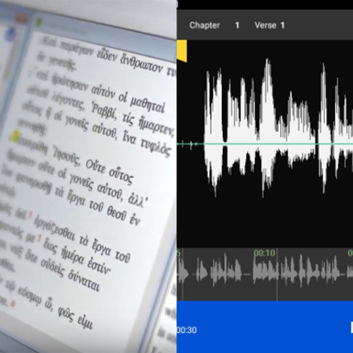
What Are Options for Translation?
If there is a writing system
Translate in writing
OR
Translate in writing and also record an audio for non-readers
If there is no commonly used writing system
Translate by speaking and produce an oral translation

Slide 10


